Slide 1
Nugget Proposal Networks for Chinese Event Detection
Hongyu Lin, Yaojie Lu, Xianpei Han, Le Sun
ACL 2018

Slide 2
Outline
Task Description
Nugget Proposal Networks
Experiments
Conclusion

Slide 3
Outline
Task Description
Nugget Proposal Networks
Experiments
Conclusion

Slide 4
Event Detection
Event detection: aims to identify event triggers of specific types
Trigger: the main word that most clearly expresses the occurrence of an event.

Slide 5
Event Detection
Predefined Event Type (33) in ACE dataset:
INJURE, DIE, MERGE_ORGANIZATION, TRANSFER-OWNERSHIP, PHONE-WRITE…
Output:
INJURE
DIE
Input: Henry was injured, and then passed away soon

Slide 6
Word-trigger Mismatch Problem
1: a trigger can be part of a word
Output:
MERGE_ORGANIZATION
TRANSFER_OWNERSHIP
Input: 这家/ 公司/ 并购/ 了/ 多家/ 公司/

Slide 7
Word-trigger Mismatch Problem
2: a trigger can cross words
Output:
INJURE
Input: 那个/ 受/ 了/ 伤/ 的/ 士兵/ 不治/ 身亡/ 。

Slide 8
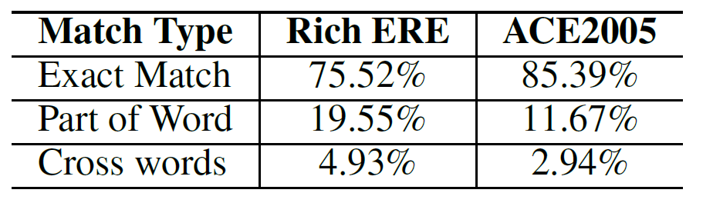
Percentages of different types of matches

Slide 9
Outline
Task Description
Nugget Proposal Networks
Experiments
Conclusion

Slide 10
One Baseline Model
Character-based Convolution BiLSTM network
Notes:
Word-level information
Since the trigger has no Boundary limitation, it influences the recall of the result

Slide 11
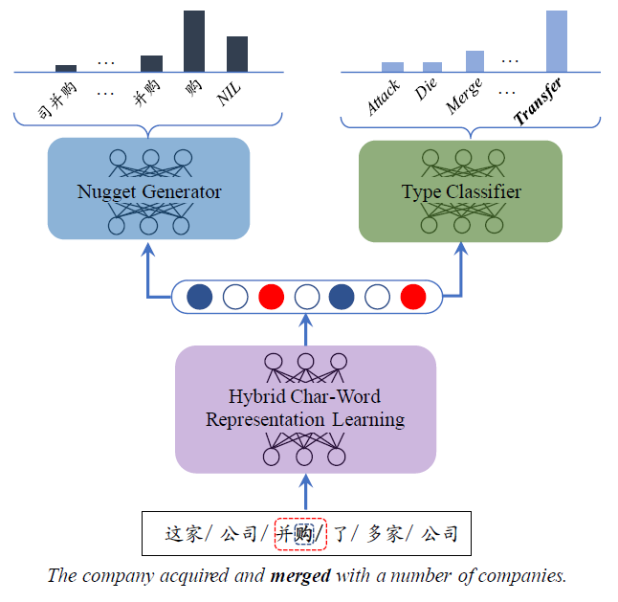
Nugget Proposal Networks(NPN)

Slide 12
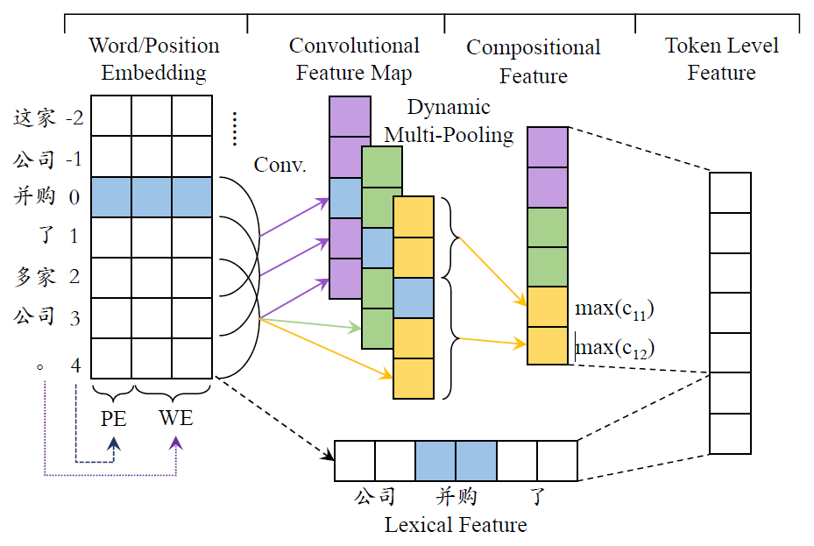
Representation in NPN

Slide 13
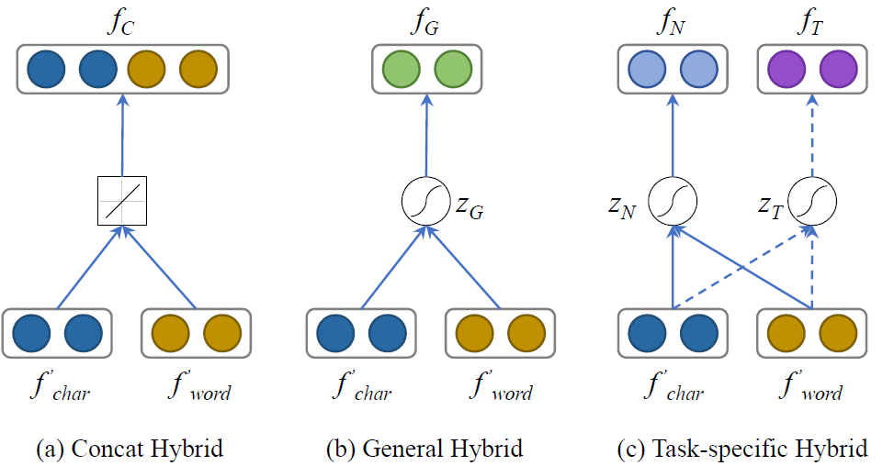
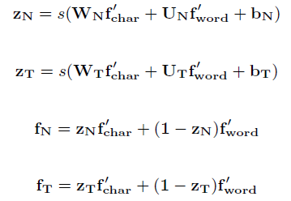
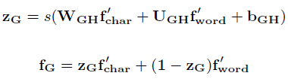

Representation in NPN

Slide 14
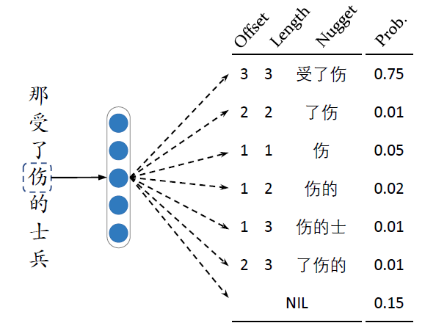
Trigger Nugget Generator

Slide 15
Dealing with Conflicts between Proposed Nuggets
那个 受 了 伤 的 士兵
那个 受 了 伤 的 士兵
受了伤
受了伤
NIL
伤
NIL/trigger conflict
overlapped conflict

Slide 16
Event Type Classifier
那个 受 了 伤 的 士兵
INJURE
DIE
MERGE_ORGANIZATION
PHONE-WRITE

Slide 17
Nugget Proposal Networks

Slide 18
Outline
Task Description
Nugget Proposal Networks
Experiments
Conclusion

Slide 19
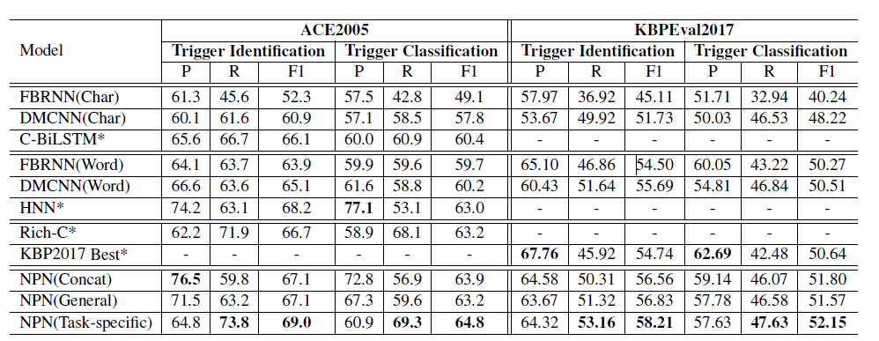
Experiment results on ACE2005 and KBPEval2017.

Slide 20
Conclusion
Structural and semantic information from both characters and words benefits the representation.
Task-specific hybrid representation for the separate task is good for the entire network.

Slide 21
Thanks

